Slide 1
I/O-classroom-slides

Slide 2
Computer
Device Controller
Input/Output Device

Slide 3

7
0
Data register
7
0
Ready
IF
…
IE
Status register
Keyboard controller

Slide 4
Memory mapped I/O
CPU
Address
Data
7
0
Main memory
Data register
(address = 5000)
7
0
Ready
IF
…
IE
Status register
(address = 5002)
Keyboard controller

Slide 5
Processor
DMA
Memory
C
Controller
Disk
Processor to Controller:
Move N bytes from disk location X
to memory location M

Slide 6
DMA
CPU
Memory bus
DMA controller
Status
Command
Go
Memory
Device address
Memory buffer address
Count
256 bytes
Buffer

Slide 7
DMA Transfer example
Memory bus
DMA controller
Buffer
Memory
Mem Buf
Destination
on Device

Slide 8
PCI bus with System Bus
Bus
Address and data lines
Command lines
INT, INTA
Bus arbitration lines
CPU
System bus
Bridge
Memory
PCI bus
Controller
Controller
Controller

Slide 9
I/O Processor
CPU
I/O processor
System bus
Bridge
I/O bus
Shared
Memory
Controller
Controller
Controller

Slide 10
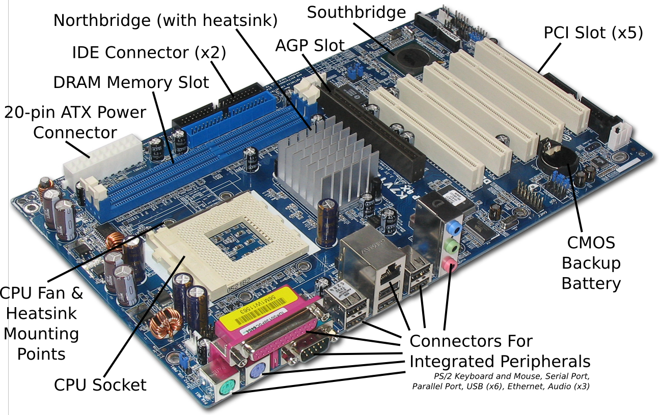

Slide 11
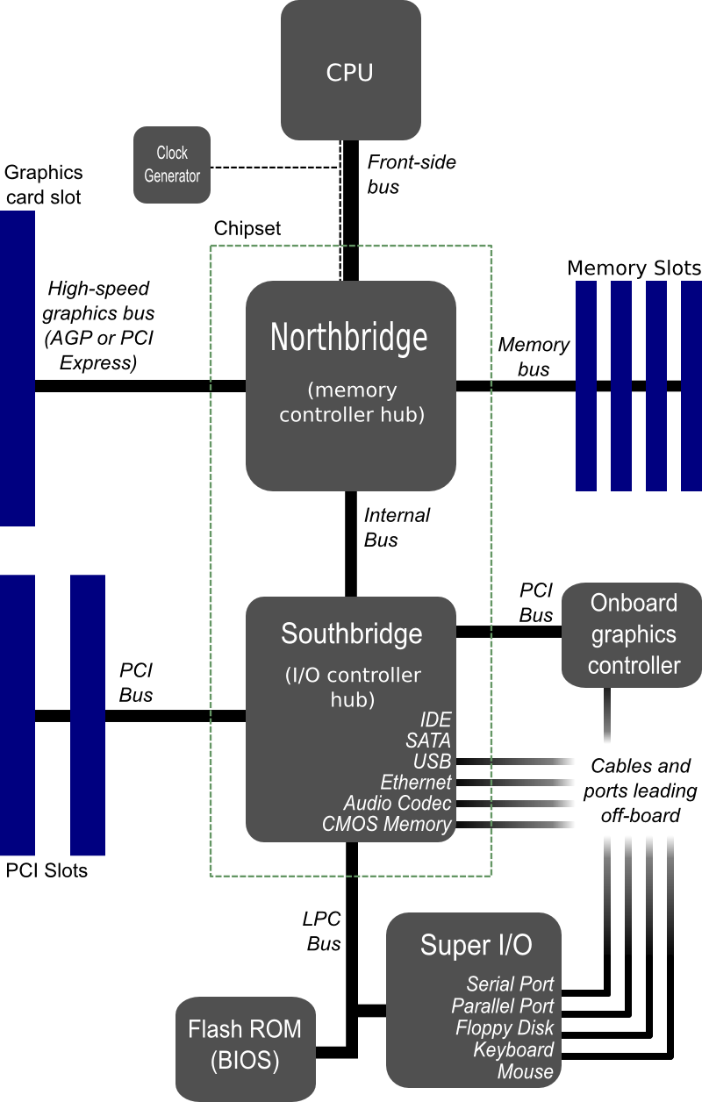

Slide 12
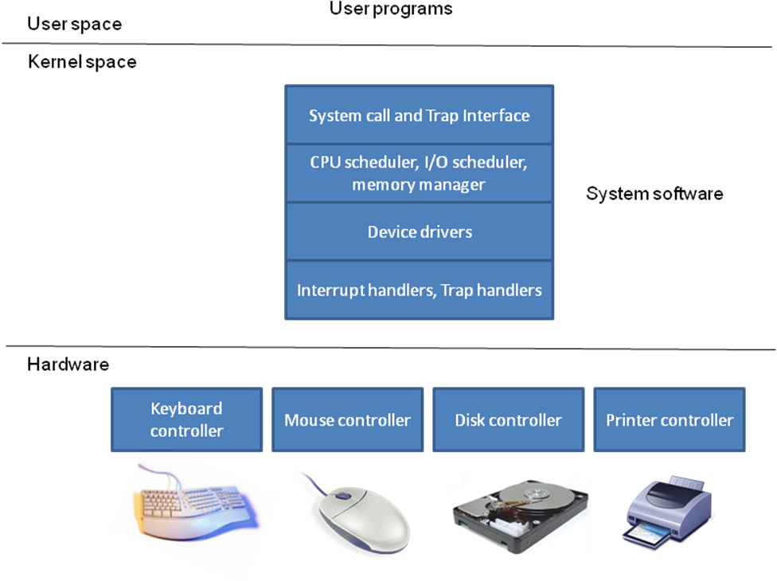
Device drivers and OS

Slide 13
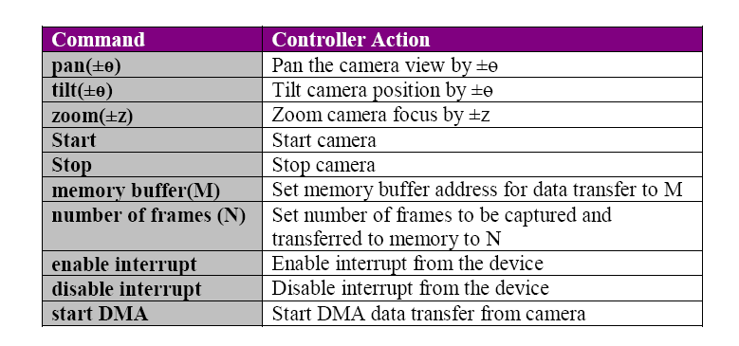
Device driver: An example

Slide 14
Modules in the example device driver
camera_position_control
(angle pan_angle; angle tilt_angle; int z)
{
pan(pan_angle);
tilt(tilt_angle);
zoom(z);
}
// Set up DMA parameters for data transfer
camera_DMA_parameters(address mem_buffer;int num_frames)
{
memory_buffer(mem_buffer);
capture_frames(num_frames);
}

Slide 15
// Start DMA transfer
camera_start_data_transfer()
{
start_camera();
start_DMA();
}
// Stop DMA transfer
camera_stop_data_transfer();
{
// automatically aborts data transfer
// if camera is stopped;
stop_camera();
}

Slide 16
// Enable interrupts from the device
camera_enable_interrupt()
{
enable_interrupt();
}
// Disable interrupts from the device
camera_disable_interrupt()
{
disable_interrupt();
}

Slide 17
// Device interrupt handler
camera_interrupt_handler()
{
// This will be coded similar to any
// interrupt handler we have seen in
// chapter 4.
//
// The upshot of interrupt handling may
// to deliver “events” to the upper layers
// of the system software (see Figure 10.9)
// which may be one of the following:
// - normal I/O request completion
// - device errors for the I/O request
//
}

Slide 18
Device | Input/output | Human in the loop | Data rate (circa 2008) | PIO | DMA
Keyboard | Input | Yes | 5-10 bytes/sec | X
Mouse | Input | Yes | 80-200 bytes/sec | X
Graphics display | Output | No | 200-350 MB/sec |  | X
Disk (hard drive) | Input/Output | No | 100-200 MB/sec |  | X
Network (LAN) | Input/Output | No | 1 Gbit/sec |  | X
Modem | Input/Output | No | 1-8 Mbit/sec |  | X
Inkjet printer | Output | No | 20-40 KB/sec | X | X
Laser printer | Output | No | 200-400 KB/sec |  | X
Voice (microphone/speaker) | Input/Output | Yes | 10 bytes/sec | X
Flash memory | Input/Output | No | 10-50 MB/sec |  | X
CD-RW | Input/Output | No | 10-20 MB/sec |  | X
DVD-R | Input | No | 10-20 MB/sec |  | X

Slide 19
Magnetic Disk
P
l
a
t
t
e
r
s
T
r
a
c
k
s
P
l
a
t
t
e
r
S
e
c
t
o
r
s
T
r
a
c
k

Slide 20
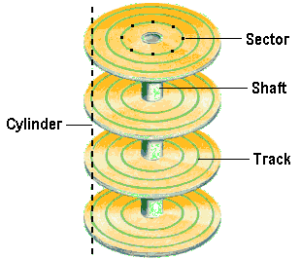
Typical:
Seagate Barracuda-8
7200 RPM
Seek: 8 ms
Rot lat: 4 ms
Platter size – 133 GB
Tot cap – 400 GB
Xfer rate – 150 MB/sec
Recording surface
On both sides

Slide 21
Let,
p – number of platters,
n – number of surfaces per platter (1 or 2),
t – number of tracks per surface,
s – number of sectors per track,
b – number of bytes per sector,
The total capacity of the disk:
Capacity = (p * n * t * s* b) bytes

Slide 22
Example
Suppose a disk drive has 256 bytes per sector, 12 sectors per track, 100 tracks per surface and 6 platters. What is the total capacity of such a drive in bytes?

Slide 23
Let,
r – rotational speed of the disk in RPM,
s – number of sectors per track,
b – number of bytes per sector,
Time for one revolution = 60/r seconds
Amount of data read in one revolution = s *b bytes
The data transfer rate of the disk:
(Amount of data in track) / (time for one revolution)
= (s * b)/(60/r)
Data transfer rate
= (s * b * r) / 60 bytes/second

Slide 24
Example :
Given the following specifications for a disk drive:
512 bytes per sector
400 sectors per track
6000 tracks per surface
3 platters
Rotational speed 15000 RPM
What is the transfer rate of the disk?

Slide 25
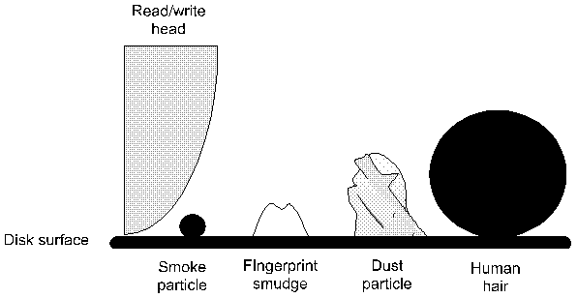

Slide 26
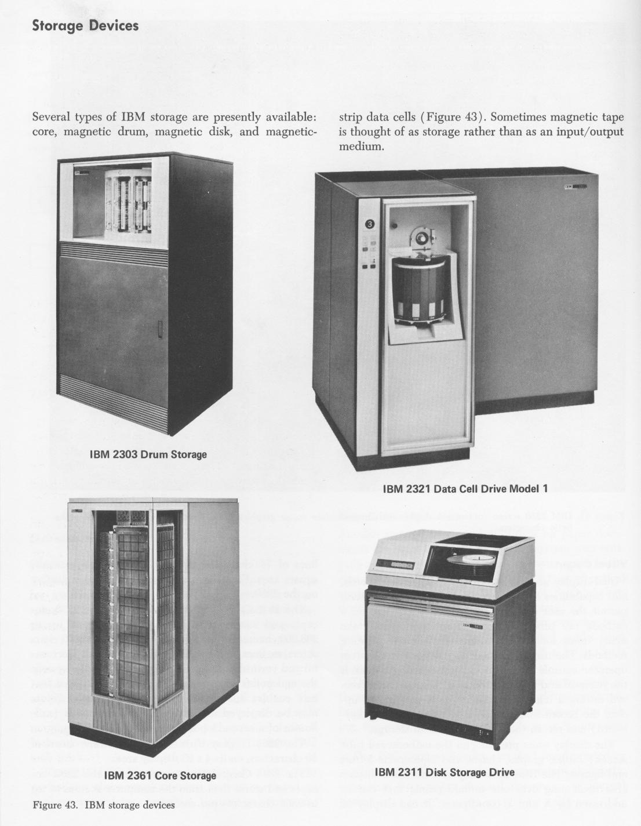
Introduced
in early 60’s

Slide 27
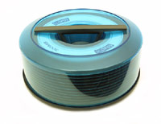

Slide 28
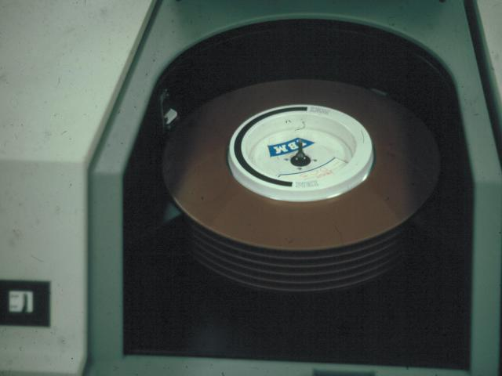

Slide 29
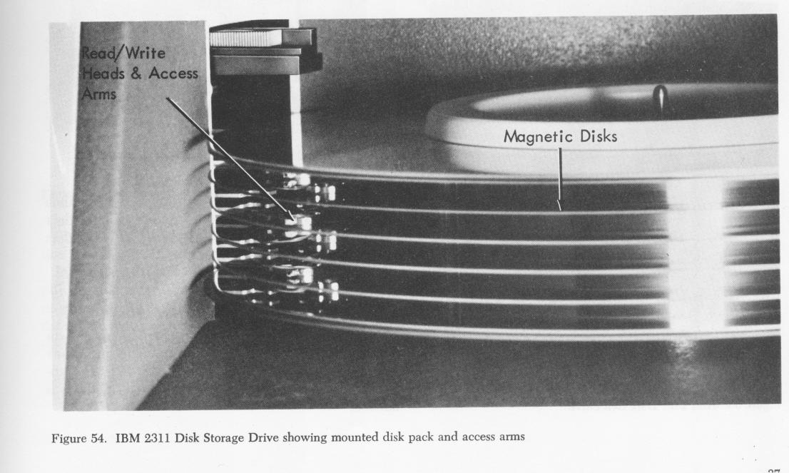
Early 60’s – capacity per removable pack 7.25 MB

Slide 30
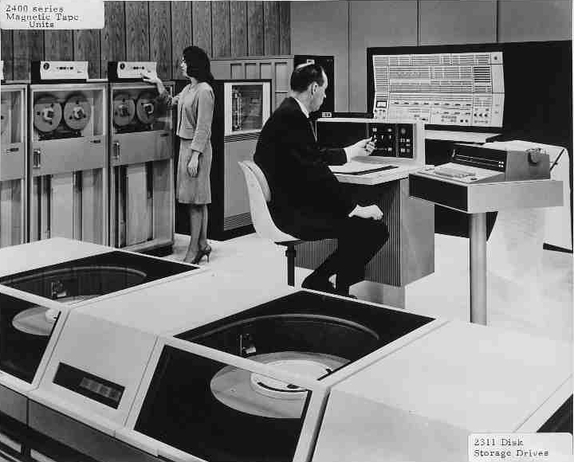

Slide 31
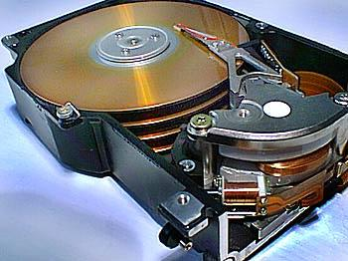

Slide 32
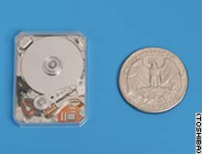
4 GB drive

Slide 33
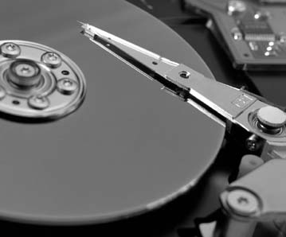

Slide 34
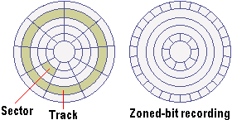
Zoned recording
Outer tracks more
sectors

Slide 35
With zoned recording,
z – number of zones,
t_{zi} – number of tracks at zone z_{i},
s_{zi} – number of sectors per track at zone z_{i},
The total capacity of the disk with zoned recording:
Capacity = (p * n * (∑ (t_{zi} * s_{zi}), for 1 ≤ i ≤ z) * b) bytes

Slide 36
Example :
Given the following specifications for a disk drive:
256 bytes per sector
12 sectors per track
20 tracks per surface
3 platters
(a) What is the total capacity of such a drive in bytes assuming
normal recording?
(b) Assume a zoned bit recording with 3 zones
Zone 3 (outermost): 8 tracks, 18 sectors per track
Zone 2: 7 tracks, 14 sectors per track
Zone 1: 5 tracks, 12 sectors per track
What is the total capacity of this drive with the
zoned-bit recording?

Slide 37
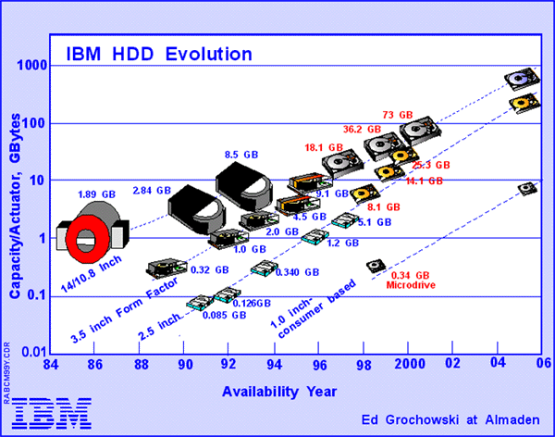

Slide 38
Let,
a – average seek time in seconds
r – rotational speed of the disk in RPM
s – number of sectors per track
Rotational latency = 60/r seconds
Average rotational latency = (60 / (r * 2)) seconds
Sector read time = rotational latency / number of sectors per track
Sector read time = ( 60 / (r * s) ) seconds

Slide 39
Time to get to the desired track
= Average seek time
= a seconds
Time to get the head over the desired sector
= Average rotational latency
= ( 60 / (r * 2) ) seconds
Time to read a sector
= Sector read time
= ( 60 / (r * s) ) seconds
Time to read a random sector on the disk
= Time to get to the desired track +
Time to get the head over the
desired track + Time to read a sector
= a + ( 60 / (r * 2) ) + ( 60 / (r * s) )
seconds

Slide 40
Example :
Given the following specifications for a disk drive:
256 bytes per sector
12 sectors per track
20 tracks per surface
3 platters
Average seek time of 20 ms
Rotational speed 3600 RPM
Normal recording
What would be the time to read 6 contiguous sectors
from the same track?
What would be the time to read 6 sectors at random?

Slide 41
request_q
Track = t1
Track = t2
Track = t3
Track = t4
…..

Slide 42
Name | Notation | Units | Description
Throughput | n/T | Jobs/sec | System-centric metric quantifying the number of I/O requests n executed in time interval T
Avg. Turnaround time (t_{avg}) | (t₁+t₂+…+t_{n})/n | Seconds | System-centric metric quantifying the average time it takes for a job to complete
Avg. Waiting time (w_{avg}) | ((t₁-e₁) + (t₂-e₂)+ … + (t_{n}-e_{n}))/n or (w₁+w₂+ … +w_{n})/n | Seconds | System-centric metric quantifying the average waiting time that an I/O request experiences
Response time/ turnaround time | t_{i} | Seconds | User-centric metric quantifying the turnaround time for a specific I/O request i
Variance in Response time | E[(t_{i} – t_{avg})²] | Seconds² | User-centric metric that quantifies the statistical variance of the actual response time (t_{i}) experienced by an I/O request i from the expected value (t_{avg})
Variance in Wait time | E[(w_{i} – w_{avg})²] | Seconds² | User-centric metric that quantifies the statistical variance of the actual wait time (w_{i}) experienced by an I/O request i from the expected value (w_{avg})
Starvation | - | - | User-centric qualitative metric that signifies denial of service to a particular I/O request or a set of I/O request due to some intrinsic property of the I/O scheduler

Slide 43
request_q
Track = t1
Track = t2
Track = t3
Track = t4
…..
FCFS
t3
t1
t4
t2
head

Slide 44
request_q
Track = t1
Track = t2
Track = t3
Track = t4
…..
SSTF
t3
t1
t4
t2
head

Slide 45
request_q
Outermost track
SCAN
Track = t1
Track = t2
Track = t3
Track = t4
…..
Innermost track
head
t3
t1
t4
t2
t6
t5

Slide 46
Outermost track
request_q
Track = t1
Track = t2
Track = t3
Track = t4
…..
C-SCAN
Innermost track
head
t3
t1
t4
t2
Retract
t6
t5

Slide 47
Outermost track
request_q
Track = t1
Track = t2
Track = t3
Track = t4
…..
LOOK
Innermost track
t3
t1
t4
t2
head
t5
t6
head

Slide 48
Outermost track
request_q
Track = t1
Track = t2
Track = t3
Track = t4
…..
C-LOOK
Innermost track
t3
t1
t4
t2
head
t5
t6
head

Slide 49
Example :
Given the following:
Total number of cylinders in the disk=200 (numbered 0 to 199)
Current head position =cylinder 23
Current requests in order of arrival=20, 17, 55, 35, 25, 78, 99
R1…………………...R7
Show the schedule for the various
disk scheduling algorithms for the above set of requests.

Slide 50
Requests | FCFS | Response time SSFT | LOOK
R1 (cyl 20) | 3 | 7 | 155
R2 (cyl 17) | 6 | 10 | 158
R3 (cyl 55) | 44 | 48 | 32
R4 (cyl 35) | 64 | 28 | 12
R5 (cyl 25) | 74 | 2 | 2
R6 (cyl 78) | 127 | 71 | 55
R7 (cyl 99) | 148 | 92 | 76
Average | 66.4 | 36 | 70

Slide 51

FCFS

Slide 52

SSTF

Slide 53
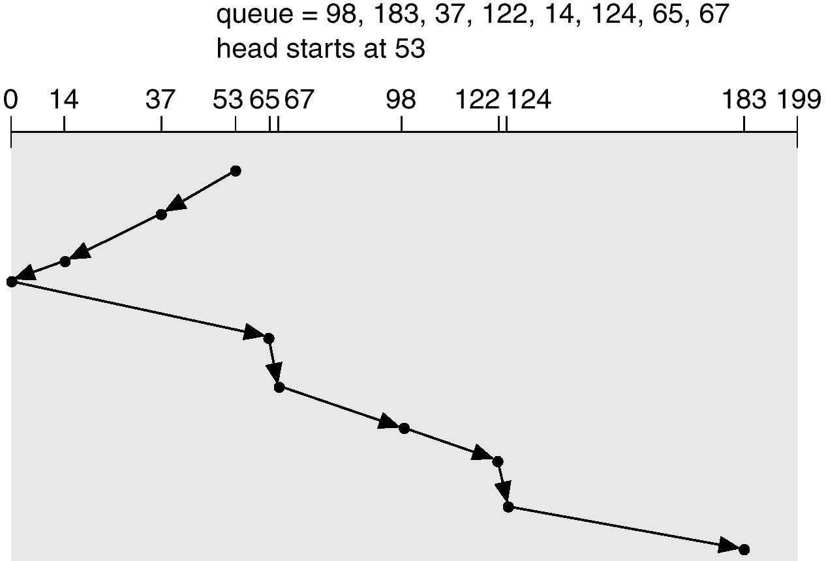
SCAN

Slide 54

C-Scan

Slide 55

C-Look

